Slide 1
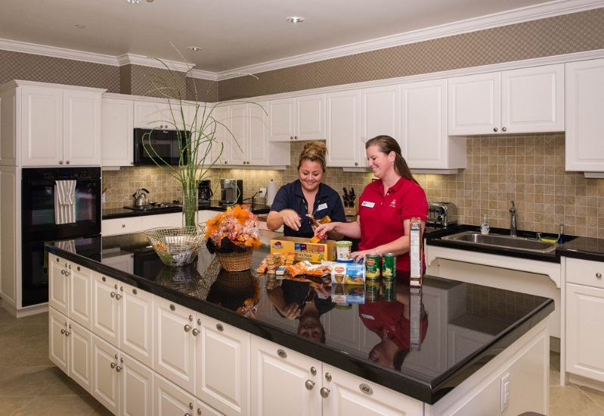
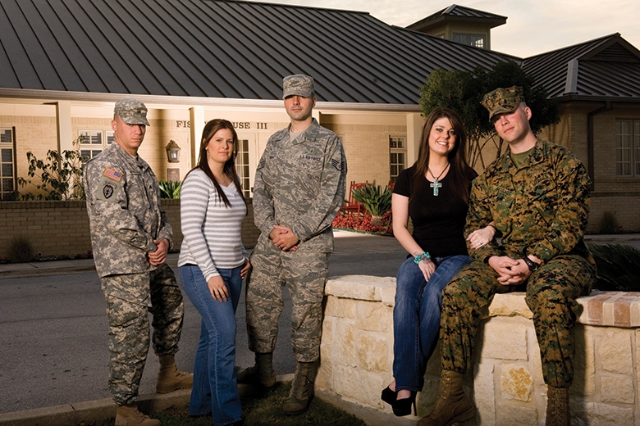
Join the ASMC Gulf Coast Chapter
as we support the Eglin Fisher House
The Fisher House provides military & veteran families with no cost lodging while their loved one receives medical treatment in the Eglin area.
This can be stressful enough without worrying about what to cook for dinner. You can help by volunteering to prepare and serve dinner to the guests of the Eglin Fisher House. Opportunities are twice monthly, from 1600-1900 hours.
For more information or to volunteer,
please contact Arielle MacKendree at
arielle.mackendree@us.af.mil
DSN 875-4593 or Comm (850) 883-4593
http://www.gulfcoastasmc.org/community.html

